Slide 1


May 2025
82 Below:
Visualizing Lead Service Lines and Lead Risk in Chicago
82 Below: Obaid Bin-Mahfoudh, Sebastian Buzenas, Gavin Coffer, Pranav Kuchibhotla, Thailer Simmons

Slide 2
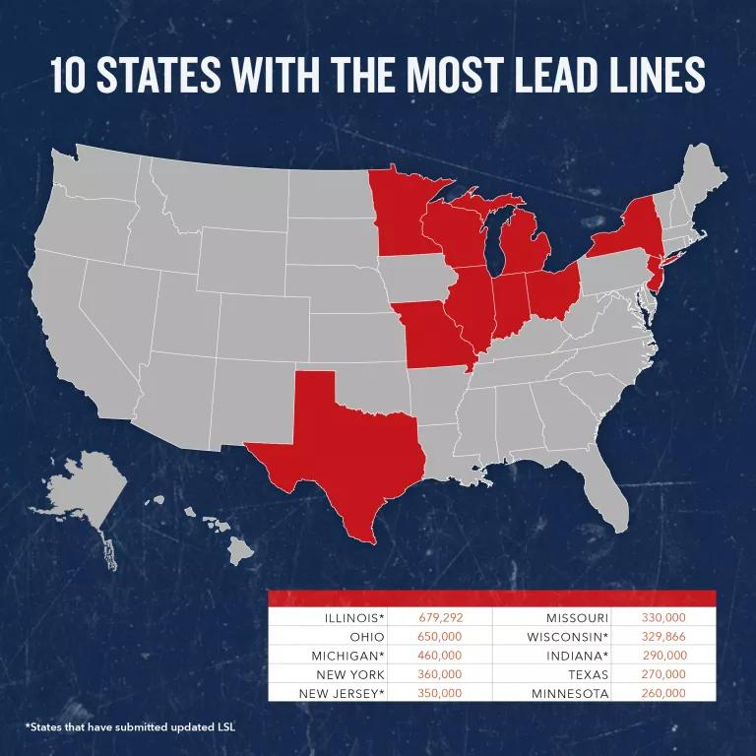
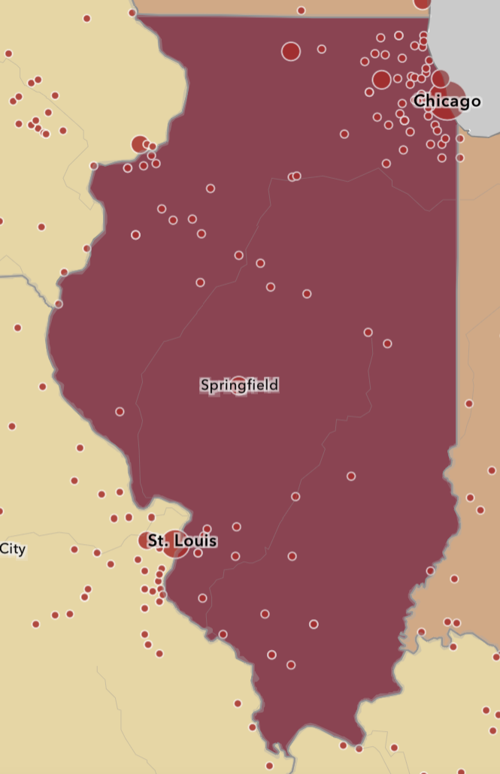
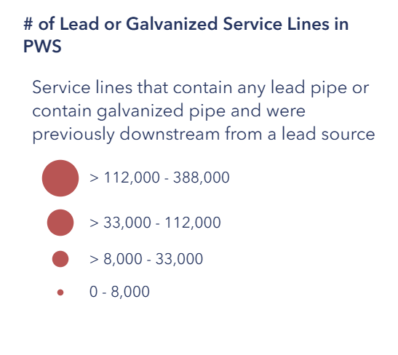
What is Happening in Chicago’s Pipes?
The city of Chicago is estimated to contain over 400,000 lead service lines- more than any other city in the U.S.
Source: NRDC 2024
Service lines are pipes that connect homes and businesses to the city’s water supply via water mains.
Until 1986, lead was the pipe material mandated by city ordinance for use in service line construction
Illinois is home to the most lead lines, with Chicago accounting for ~58% of lead lines

Slide 3
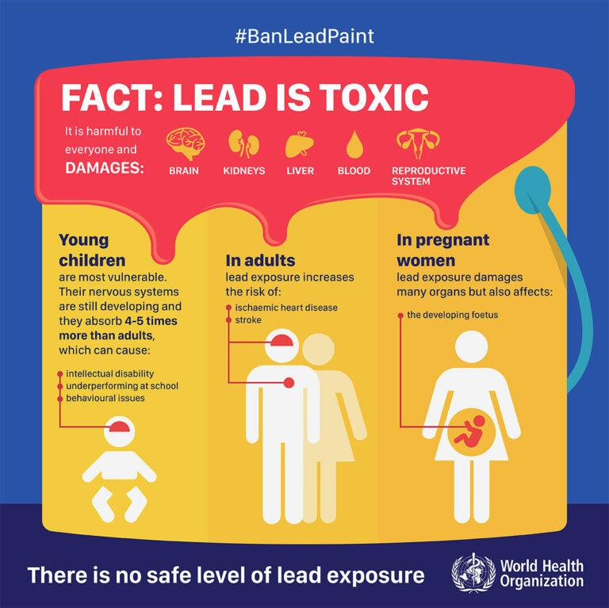
Lead Toxicity
There is no safe lead exposure level. ANY exposure can cause:
Cognitive impairment/ learning disability
Behavioral problems
Lowered IQ
Anaemia
These issues are most detrimental in children and pregnant people who can leach lead to their fetuses. Due to the cumulative nature of lead poisoning, early onset of poisoning can affect a child’s entire lifetime.
Lead is a known neurotoxin that accumulates in the body for a person’s entire lifetime.

Slide 4

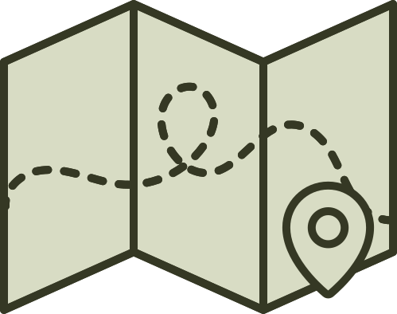



Approach
Our approach to understanding lead risk in Chicago consisted of:
01
02
03
04
05
Data Collection
Hotspot Lead
Risk Analysis
Cost Analysis/Risk Model
Temperature Dependence Analysis
Conclusions

Slide 5
01
Data Collection
Data Sources: FOIA Release, US Census Bureau, The Guardian US, EPA , NWS
Factors to consider | Notes
Hotspot analysis | Transparency for lead service lines in Chicago Identify areas for service line replacement to ensure equity and helping our most vulnerable population Identify improvements to lead testing strategies
Risk Model | City of Chicago geometry data: City of Chicago website. Census block group geometries: Census website ADI Score: Neighborhood Atlas Children under 5 data: Census ACS Lead service line data: FOIA Request from City of Chicago.
Lead temperature draws | Risk of lead poisoning to our most vulnerable population and those who cannot adequately respond to lead poisoning.
Benefits of taking action What are the benefits of making the change? | Ensure transparency to the residents of Chicago. Helping ensure prioritization for our most vulnerable population

Slide 6

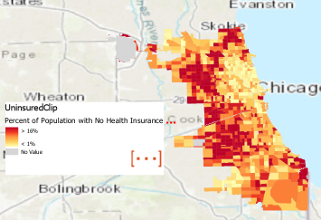
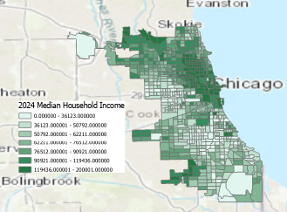
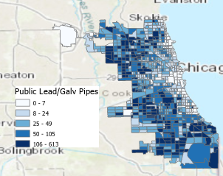
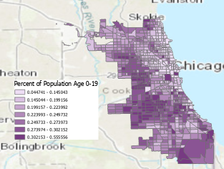
02
Hotspot Lead Risk Analysis
Questions
Key Indicators
Where is lead most likely to be within the city?
Where are people most unprepared to handle lead exposure?
Where are both of these factors present?
Private and Public LSL density
Census Demographics: Population under 19, Population Uninsured, Median Household Income
Normalized as percents

Slide 7
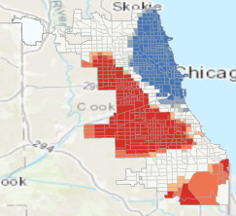
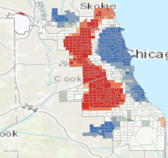
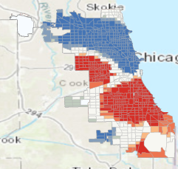
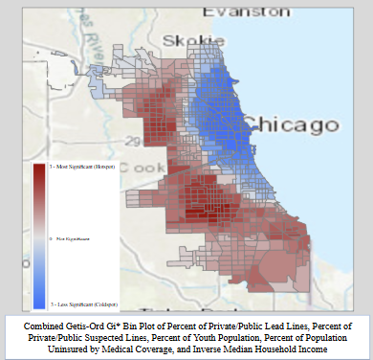
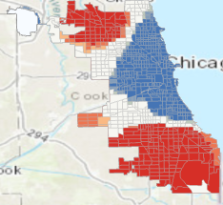
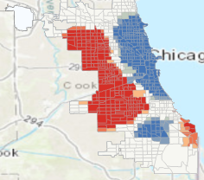
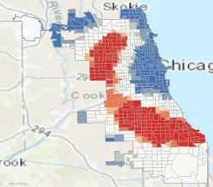
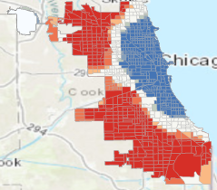
02
Hotspot Lead Risk Analysis
Hotspot Methodology
Key Findings
Where is the statistic unusually high given the statistics surrounding it?
Use of Gi* Statistic to determine spatial hotspots
Locating significant hot and cold spots
Combining hotspot maps
Youth, Uninsured, Inverse Income Hotspots - Demographics
Private/Public Lead and Suspected Lead Hotspots - Lead Presence

Slide 8
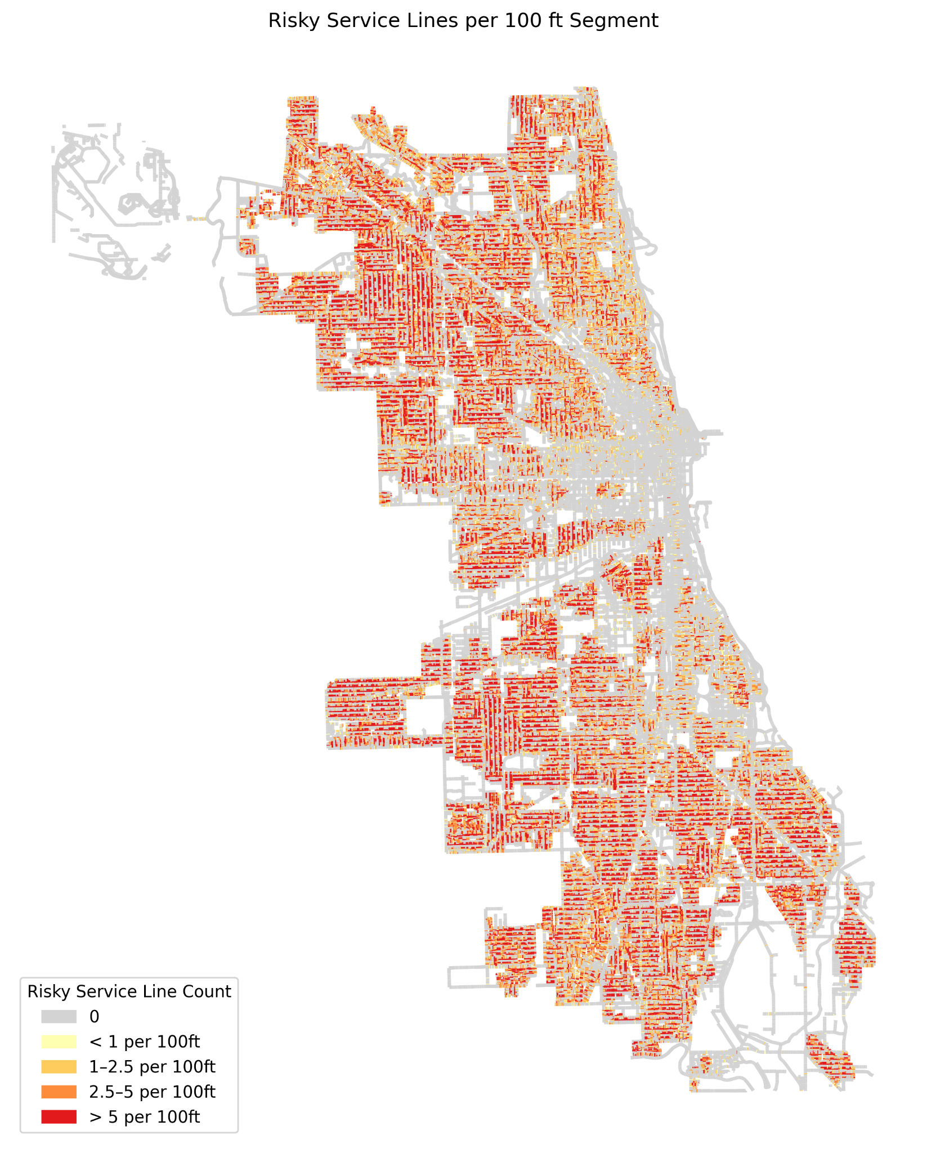
More Granular Service line replacement
03
After setting priorities by block groups we can get more granular and prioritize streets within a block group. This will be done by determining the number of risky service lines per 100 ft.

Slide 9
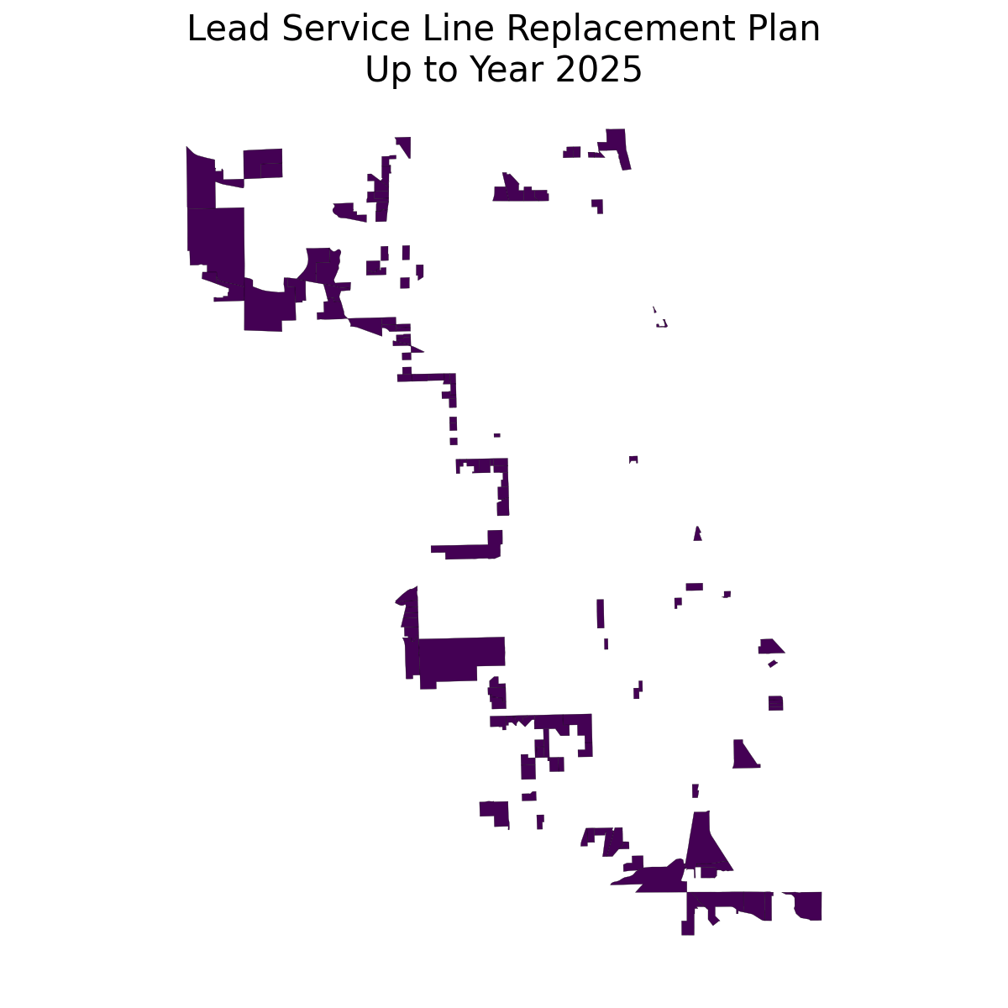
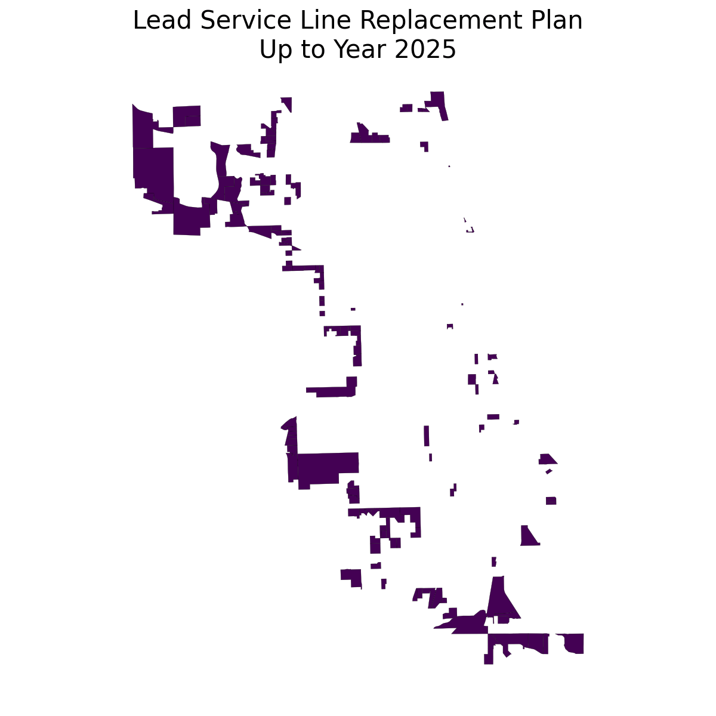
Partial Service line replacement
2025–⁠2165
Full Service line replacement
2025–⁠2172
Assumptions:
Cost of replacement: $16,000
Annual budget:
53 million
Predicted cost:
$7,789,120,000.00
Predicted cost:
$7,413,016,000.00

Slide 10
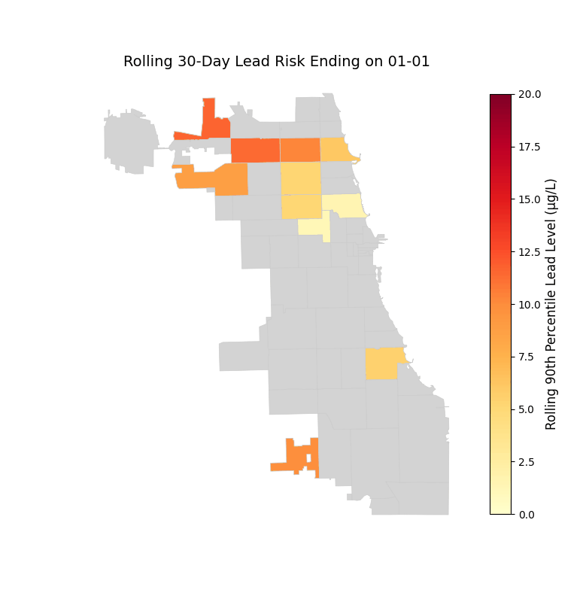
Animated 30-Day Rolling Lead Exposure Levels (ZIP Code-wise)
This animation shows the 90th percentile of lead levels using a 30-day rolling window for each Chicago ZIP code.
For each day, it looks at lead samples from the previous 30 days to highlight unusually high contamination levels.
Darker red = higher lead risk
Grey = not enough data
Lead risk rises in summer and drops in winter, revealing clear seasonal patterns.
This helps pinpoint when and where lead exposure risk rises.

